Slide 1

Master en Física y Tecnología de los Láseres
Jorge Souto

Slide 2


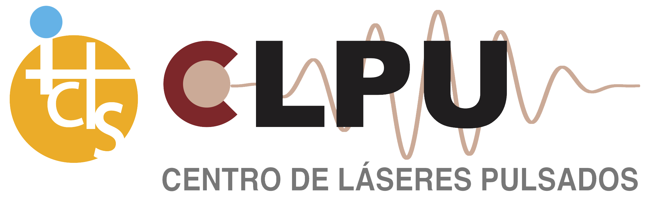

Master en Física y Tecnología de los Láseres
Colaboran
Notes:
Universidades de Salamanca (Área de Óptica, Departamento de Ingeniería Mecánica, Departamento de Física Fundamental) y de Valladolid (Área de Óptica del Departamento de Física Teórica, Atómica y Óptica, Grupo de Semiconductores del Departamento de Física de la Materia Condensada Cristalografía y Mineralogía, y Departamento Teoría de la Señal y Comunicaciones e Ingeniería Telemática)
El Centro Español de Láseres Pulsados se creó en diciembre de 2007 como un Consorcio integrado por el Ministerio de Ciencia, Innovación y Universidades (antiguo Ministerio de Ciencia y Educación), el Gobierno Regional de Castilla y León y la Universidad de Salamanca. Fue creado como parte de la implementación del Mapa de Infraestructuras Científicas y Técnicas Singulares (ICTS).

Slide 3
¿Por qué un máster?
Continuación natural tras el grado
Especialización
Desarrollo de habilidades
Oportunidades laborales (mercado laboral, acceso a la investigación, etc.)
Red de contactos
Notes:
Scientific Applications of Lasers
Spectroscopy:
Raman Spectroscopy: Used to study molecular vibrations and material properties.
Laser-Induced Fluorescence (LIF): For analyzing molecular compositions and dynamics in gases and liquids.
Atomic and Molecular Physics: For studying quantum mechanics, atom trapping, and cooling.
Medicine and Biotechnology:
Medical Imaging: Lasers are used in confocal microscopy, optical coherence tomography (OCT), and fluorescence microscopy for high-resolution images.
Laser Surgery: Precision cutting in eye surgery (e.g., LASIK) and soft tissue surgeries (e.g., dermatology).
Photodynamic Therapy (PDT): Treatment for cancers using lasers to activate photosensitizing drugs.
Quantum Computing and Information:
Quantum Communication: Lasers are used in quantum key distribution (QKD) for highly secure data transmission.
Quantum Computing: They help control qubits (quantum bits) in quantum computers.
Optical Trapping: Used to manipulate atoms or particles in quantum experiments.
Astronomy and Space:
Laser Ranging: Used in satellite tracking, lunar laser ranging experiments, and Earth mapping.
Laser Guide Stars: Artificial stars created to help telescopes adjust for atmospheric distortions.
Interstellar Communication: Potential future use in deep-space communication via laser signals.
Fundamental Physics:
High-Energy Laser Physics: Exploring extreme states of matter and plasma physics.
Gravitational Wave Detection: Used in devices like LIGO (Laser Interferometer Gravitational-Wave Observatory) to detect spacetime ripples.
Fusion Research: Inertial confinement fusion (ICF) uses lasers to heat and compress fuel pellets.
Industrial Applications of Lasers
Manufacturing and Materials Processing:
Laser Cutting: For precise cutting of materials like metals, plastics, and textiles.
Laser Welding: For joining metals and polymers with high precision and minimal heat distortion.
Laser Engraving and Marking: Permanent marking of logos, serial numbers, or barcodes on products.
Laser Drilling: Precision drilling in metals, ceramics, and semiconductors.
Additive Manufacturing (3D Printing): Laser sintering and melting processes for building complex parts layer by layer.
Telecommunications:
Fiber Optic Communication: Lasers are the backbone of high-speed internet transmission through optical fibers.
Data Storage: Used in CD, DVD, and Blu-ray technologies for reading and writing data.
Automotive and Aerospace:
Laser Scanning and Measurement: 3D laser scanners are used for reverse engineering and quality control in automotive and aerospace components.
Laser Cleaning: Removing rust, paint, or contaminants from metal surfaces without damaging the material.
Defense and Security:
Laser Weaponry: Development of laser-based weapons systems for target destruction and defense.
LIDAR (Light Detection and Ranging): Used for autonomous vehicles and mapping environments for military surveillance.
Laser Target Designation: For precision-guided munitions in military operations.
Environmental Monitoring and Remote Sensing:
Atmospheric Monitoring: Laser systems measure pollutants and greenhouse gases.
Laser Altimetry: Used in geospatial mapping and terrain analysis.
LIDAR in Agriculture: For monitoring crop health and optimizing farming techniques.
Entertainment and Holography:
Laser Shows: For visual effects in concerts, theaters, and entertainment venues.
Holography: 3D holographic imaging, used in security, advertising, and art.
Augmented Reality (AR) and Virtual Reality (VR): Lasers are integral in developing projection systems for immersive experiences

Slide 4
Aplicaciones de los láseres
Espectroscopía
Física de campos intensos (plasmas, altas energías, aceleración, fusión, astrofísica
Biotecnología
Interacción luz-materia (procesos no lineales, attociencia)
Dinámicas ultrarrápìdas (femtoquímica, Física atómica y molecular…)
Computación cuántica
Científicas
Créditos de imágenes
https://doi.org/10.31635/ccschem.023.202303425
DESY/SciComLab
Takafumi Tomita (IMS)
Francesca Calegari (DESY)
Ignacio López Quintás (USAL)
Notes:
Scientific Applications of Lasers
Spectroscopy:
Raman Spectroscopy: Used to study molecular vibrations and material properties.
Laser-Induced Fluorescence (LIF): For analyzing molecular compositions and dynamics in gases and liquids.
Atomic and Molecular Physics: For studying quantum mechanics, atom trapping, and cooling.
Medicine and Biotechnology:
Medical Imaging: Lasers are used in confocal microscopy, optical coherence tomography (OCT), and fluorescence microscopy for high-resolution images.
Laser Surgery: Precision cutting in eye surgery (e.g., LASIK) and soft tissue surgeries (e.g., dermatology).
Photodynamic Therapy (PDT): Treatment for cancers using lasers to activate photosensitizing drugs.
Quantum Computing and Information:
Quantum Communication: Lasers are used in quantum key distribution (QKD) for highly secure data transmission.
Quantum Computing: They help control qubits (quantum bits) in quantum computers.
Optical Trapping: Used to manipulate atoms or particles in quantum experiments.
Astronomy and Space:
Laser Ranging: Used in satellite tracking, lunar laser ranging experiments, and Earth mapping.
Laser Guide Stars: Artificial stars created to help telescopes adjust for atmospheric distortions.
Interstellar Communication: Potential future use in deep-space communication via laser signals.
Fundamental Physics:
High-Energy Laser Physics: Exploring extreme states of matter and plasma physics.
Gravitational Wave Detection: Used in devices like LIGO (Laser Interferometer Gravitational-Wave Observatory) to detect spacetime ripples.
Fusion Research: Inertial confinement fusion (ICF) uses lasers to heat and compress fuel pellets.
Industrial Applications of Lasers
Manufacturing and Materials Processing:
Laser Cutting: For precise cutting of materials like metals, plastics, and textiles.
Laser Welding: For joining metals and polymers with high precision and minimal heat distortion.
Laser Engraving and Marking: Permanent marking of logos, serial numbers, or barcodes on products.
Laser Drilling: Precision drilling in metals, ceramics, and semiconductors.
Additive Manufacturing (3D Printing): Laser sintering and melting processes for building complex parts layer by layer.
Telecommunications:
Fiber Optic Communication: Lasers are the backbone of high-speed internet transmission through optical fibers.
Data Storage: Used in CD, DVD, and Blu-ray technologies for reading and writing data.
Automotive and Aerospace:
Laser Scanning and Measurement: 3D laser scanners are used for reverse engineering and quality control in automotive and aerospace components.
Laser Cleaning: Removing rust, paint, or contaminants from metal surfaces without damaging the material.
Defense and Security:
Laser Weaponry: Development of laser-based weapons systems for target destruction and defense.
LIDAR (Light Detection and Ranging): Used for autonomous vehicles and mapping environments for military surveillance.
Laser Target Designation: For precision-guided munitions in military operations.
Environmental Monitoring and Remote Sensing:
Atmospheric Monitoring: Laser systems measure pollutants and greenhouse gases.
Laser Altimetry: Used in geospatial mapping and terrain analysis.
LIDAR in Agriculture: For monitoring crop health and optimizing farming techniques.
Entertainment and Holography:
Laser Shows: For visual effects in concerts, theaters, and entertainment venues.
Holography: 3D holographic imaging, used in security, advertising, and art.
Augmented Reality (AR) and Virtual Reality (VR): Lasers are integral in developing projection systems for immersive experiences

Slide 5
Aplicaciones de los láseres
Entretenimiento y holografía
Telecomunica-
ciones
Diagnósticos (espectroscopía, LIDAR, sensado atmosférico, agrícola, etc.)
Óptica integrada
Fotónica
Procesado e ingeniería de materiales (superficies, manufactura aditiva, etc.)
Tecnológicas
Créditos de imágenes
Javier Rodríguez (USAL)
Fundación Pacunam
Helder Crespo (Univ. Porto)
Notes:
Scientific Applications of Lasers
Spectroscopy:
Raman Spectroscopy: Used to study molecular vibrations and material properties.
Laser-Induced Fluorescence (LIF): For analyzing molecular compositions and dynamics in gases and liquids.
Atomic and Molecular Physics: For studying quantum mechanics, atom trapping, and cooling.
Medicine and Biotechnology:
Medical Imaging: Lasers are used in confocal microscopy, optical coherence tomography (OCT), and fluorescence microscopy for high-resolution images.
Laser Surgery: Precision cutting in eye surgery (e.g., LASIK) and soft tissue surgeries (e.g., dermatology).
Photodynamic Therapy (PDT): Treatment for cancers using lasers to activate photosensitizing drugs.
Quantum Computing and Information:
Quantum Communication: Lasers are used in quantum key distribution (QKD) for highly secure data transmission.
Quantum Computing: They help control qubits (quantum bits) in quantum computers.
Optical Trapping: Used to manipulate atoms or particles in quantum experiments.
Astronomy and Space:
Laser Ranging: Used in satellite tracking, lunar laser ranging experiments, and Earth mapping.
Laser Guide Stars: Artificial stars created to help telescopes adjust for atmospheric distortions.
Interstellar Communication: Potential future use in deep-space communication via laser signals.
Fundamental Physics:
High-Energy Laser Physics: Exploring extreme states of matter and plasma physics.
Gravitational Wave Detection: Used in devices like LIGO (Laser Interferometer Gravitational-Wave Observatory) to detect spacetime ripples.
Fusion Research: Inertial confinement fusion (ICF) uses lasers to heat and compress fuel pellets.
Industrial Applications of Lasers
Manufacturing and Materials Processing:
Laser Cutting: For precise cutting of materials like metals, plastics, and textiles.
Laser Welding: For joining metals and polymers with high precision and minimal heat distortion.
Laser Engraving and Marking: Permanent marking of logos, serial numbers, or barcodes on products.
Laser Drilling: Precision drilling in metals, ceramics, and semiconductors.
Additive Manufacturing (3D Printing): Laser sintering and melting processes for building complex parts layer by layer.
Telecommunications:
Fiber Optic Communication: Lasers are the backbone of high-speed internet transmission through optical fibers.
Data Storage: Used in CD, DVD, and Blu-ray technologies for reading and writing data.
Automotive and Aerospace:
Laser Scanning and Measurement: 3D laser scanners are used for reverse engineering and quality control in automotive and aerospace components.
Laser Cleaning: Removing rust, paint, or contaminants from metal surfaces without damaging the material.
Defense and Security:
Laser Weaponry: Development of laser-based weapons systems for target destruction and defense.
LIDAR (Light Detection and Ranging): Used for autonomous vehicles and mapping environments for military surveillance.
Laser Target Designation: For precision-guided munitions in military operations.
Environmental Monitoring and Remote Sensing:
Atmospheric Monitoring: Laser systems measure pollutants and greenhouse gases.
Laser Altimetry: Used in geospatial mapping and terrain analysis.
LIDAR in Agriculture: For monitoring crop health and optimizing farming techniques.
Entertainment and Holography:
Laser Shows: For visual effects in concerts, theaters, and entertainment venues.
Holography: 3D holographic imaging, used in security, advertising, and art.
Augmented Reality (AR) and Virtual Reality (VR): Lasers are integral in developing projection systems for immersive experiences

Slide 6
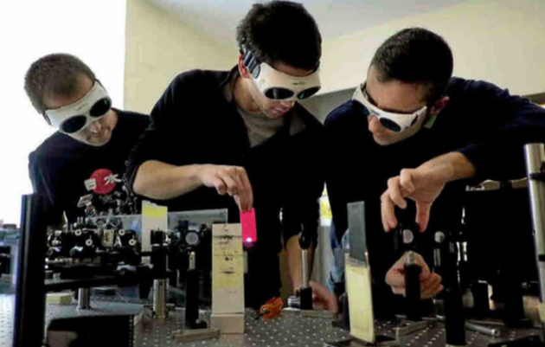
Máster de Física y Tecnología de los Láseres
Establecido | 2006
Estudiantes / año | 10
Duración | 1 año
Créditos | 60 ECTS (33 Obligatorias, 15 Optativas)
TFM | 12 ECTS
Laboratorios asociados | UVa, USAL, CLPU, CSIC.

Slide 7
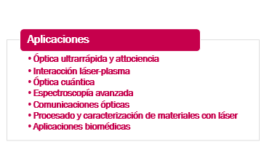
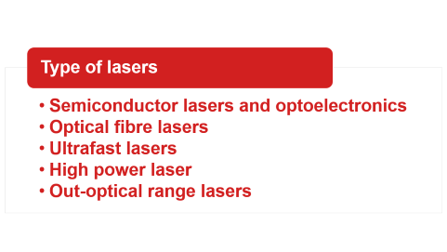
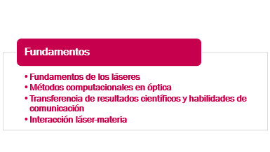
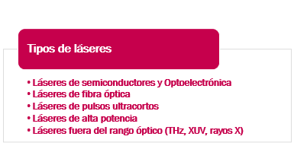
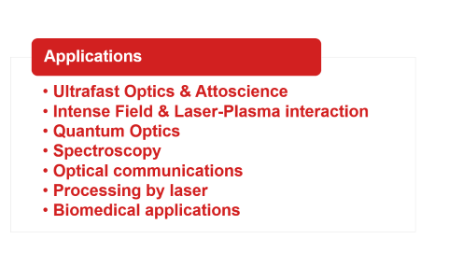
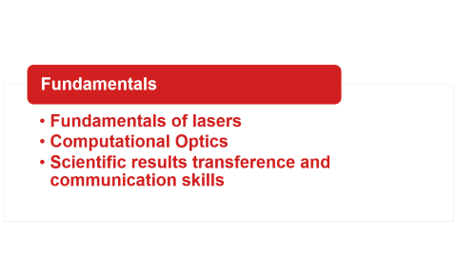
Máster de Física y Tecnología de los Láseres

Slide 8
Fundamentos
Fundamentos de los láseres
Métodos computacionales en óptica
Transferencia de resultados científicos y habilidades de comunicación
Interacción láser-materia

Slide 9
Tipos de láseres
Láseres de alta potencia
Láseres fuera del rango óptico (THz, XUV, rayos X)
Láseres de semiconductores y Optoelectrónica
Láseres de fibra óptica
Láseres de pulsos ultracortos

Slide 10
Aplicaciones
Óptica ultrarrápida y attociencia
Interacción láser-plasma
Óptica cuántica
Espectroscopía avanzada
Comunicaciones ópticas
Procesado y caracterización de materiales con láser
Aplicaciones biomédicas

Slide 11
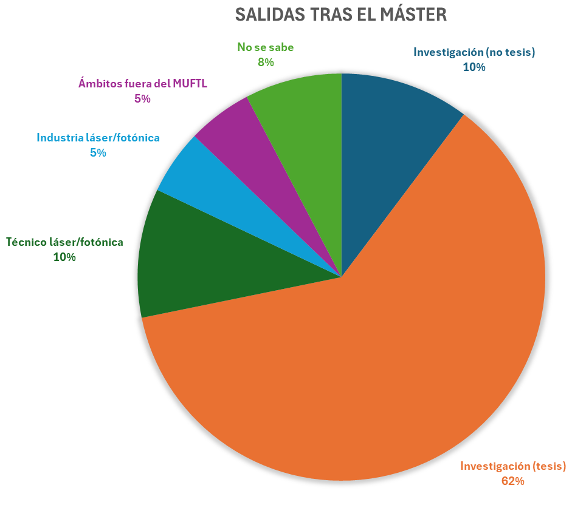
Salidas
Carrera académica e investigadora
Tecnólogos
  Centros de investigación
  Industria láser
Consultoría tecnológica
Otros
Ocupaciones de egresados del máster entre 2018/2019 y 2022/2023 (39 egresados). Fuentes: comunicaciones directas, perfiles en internet (Linkedin, ResearchGate, etc. ).

Slide 12
Conclusiones
Tras el Grado, es el momento ideal de hacer un Máster.
Formación flexible (optatividad y TFMs)
Alto porcentaje de créditos experimentales
Acceso a instalaciones punteras (CLPU, CSIC, Universidades)
Salidas profesionales (investigación, tecnología, industria…)

Slide 13
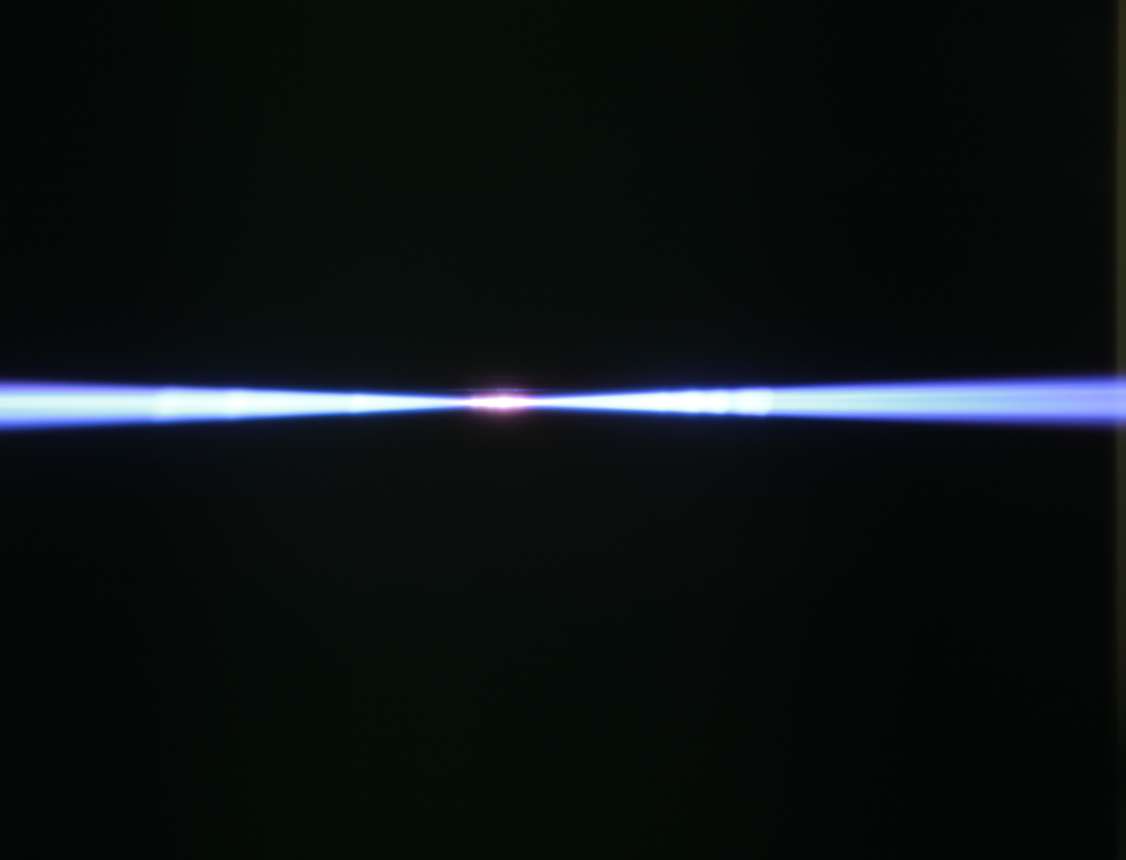
Muchas gracias
https://laser.usal.es/posgrado/
master.fisica.laser@uva.es
master.laser@usal.es

